Slide 1


Educator Instructions
REMOVE THIS SLIDE
BEFORE PRESENTING
Customize this presentation to fit your needs. Please add or remove content.

Slide 2


The purpose of this section is to explain which atmospheric gases are considered greenhouse gases and why.
WHY ARE SOME GASES CALLED GREENHOUSE GASES?
ATHENAS is a multi-national Initiative funded by the U.S. Department of Agriculture

Slide 3
WHAT ARE GREENHOUSE GASES?
Earth’s atmosphere is composed of a variety of gases.
Some are greenhouse gases (GHGs) and others are not
Carbon dioxide and methane are important GHGs
Water is the primary GHG in our atmosphere
Non greenhouse gases, plus water, make up over 99% of the gases in the atmosphere
Only tiny amounts of helium, neon, hydrogen, and carbon monoxide gases actually exist in the atmosphere
Notes:
While many people know that carbon dioxide and methane are important GHGs, it is less common for individuals to know that water is the primary GHG in our atmosphere. It keeps the earth’s temperature relatively constant, especially compared to other planets that have extreme cold and extreme hot temperatures.

Slide 4
GHGS IN EARTH’S
ATMOSPHERE INCLUDE
Water
Carbon Dioxide
Methane
Nitrous Oxide
Ozone
CFCs/HCFCs
Sulfur Hexafluoride

Slide 5
OTHER GASES IN EARTH’S ATMOSPHERE THAT ARE NOT
GHGS INCLUDE
Nitrogen
Oxygen
Argon
Helium
Neon
Hydrogen
Carbon Monoxide

Slide 6
WHY ARE THESE NOT
GREENHOUSE GASES?
The BIG question here is “Why are nitrogen, oxygen, argon, helium, neon, hydrogen, and carbon monoxide NOT GHGs?”
Because of the symmetry of the molecules.
In the images on the next slide the line of symmetry is shown with
a green line.
Notes:
The BIG question here is “Why are nitrogen, oxygen, argon, helium, neon, hydrogen, and carbon monoxide NOT GHGs?” Most people don’t know that there is a simple answer, and that answer is related to the symmetry of the molecules. In the images on the next slide the line of symmetry is shown with a green line.

Slide 7
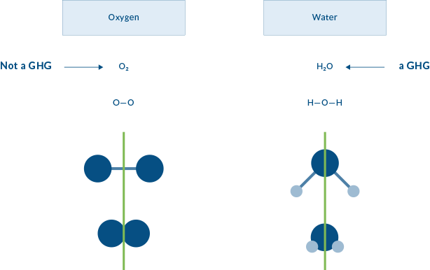
WHY SYMMETRY?
Notes:
Atoms that make up the oxygen molecule (O2) include two oxygen atoms (O-O) joined together. In this illustration the ATOMS are represented by the balls, and the BOND joining the atoms are represented by sticks. Water (H2O) has two smaller atoms of hydrogen (shown as the lighter balls) joined to the oxygen atom in the middle by two bonds. Both oxygen and water form a symmetrical molecule, but one is a greenhouse gas and one is not.

Slide 8

CARBON DIOXIDE, CO₂
Carbon dioxide, whose structure is shown by these spheres, is also symmetrical.
So if these two GHGs are both symmetrical, how do they differ from non-GHGs? What about the symmetry is different?

Slide 9
THE ANSWER COMES BACK TO LIGHT!
Changes in the distance between atoms result when IR light is absorbed.
When longer lightwaves of infrared light (IR), shown as a yellow triangle in this illustration, hits a molecule’s bond, the bond stretches. A bond can be thought of as a spring between two balls. The IR light provides the energy that makes the bond stretch just as someone would have to pull on a spring to
make it stretch. Stretching takes energy – from light.

Slide 10
CO2: CAN ITS SYMMETRY CHANGE?
So what happens to a carbon dioxide bond when IR light hits it? Just like other bonds, that bond stretches. If one bond stretches but not the other, the carbon dioxide molecule is no longer symmetrical. One bond is longer than the other so it loses its symmetry.

Slide 11
ONLY IF SYMMETRY CHANGES CAN IR LIGHT BE CAPTURED BY THE ATMOSPHERE
HERE IS THE BOTTOM LINE: A molecule is only a greenhouse gas if stretching can change its symmetry.
This happens because IR light can only change molecules that can absorb IR light energy. As it turns out, molecules whose symmetry does not change cannot absorb light in the IR region.

Slide 12

DOES THE SYMMETRY OF OTHER
GASES CHANGE?
Hydrogen, Oxygen and Nitrogen are NOT greenhouse gases.
The symmetry of these molecules cannot change. Even if the bonds were to stretch, they would not lose symmetry, so they cannot be GHGs.

Slide 13
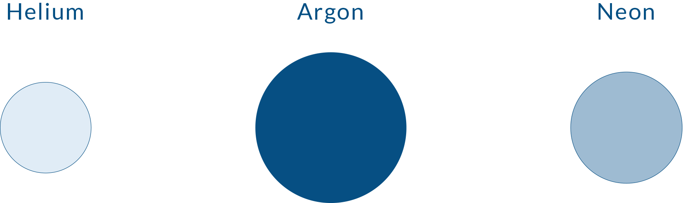
THESE ARE NOT GREENHOUSE GASES
Of course molecules without bonds cannot change their symmetry at all, so none of these are GHGs.

Slide 14

CAN WATER'S SYMMETRY CHANGE?
Water molecules can definitely change their symmetry.
Notes:
Water molecules can definitely change their symmetry so it is also an important GHG. However, there is naturally so much water in the atmosphere that the addition of more does not influence climate change quite like increases in carbon dioxide or other greenhouse gases.

Slide 15
The key point to remember is this:
ONLY GASES WITH MOLECULES WHOSE SYMMETRY CHANGES CAN BE CLASSIFIED AS GREENHOUSE GASES

Slide 16


Pacific Institute for Climate Solutions CO2 and the Greenhouse Effect (8:06 minutes) http://www.youtube.com/watch?v=sJ0eN_93l4k&feature=youtu.be
Pacific Institute for Climate Solutions More than just CO2 (5:23 minutes) http://www.youtube.com/watch?v=fA9NwUiU4sU&feature=youtu.be
Changing Climates, Colorado State University, Why Greenhouse Gases Make the Planet Warmer http://changingclimates.colostate.edu/movies/scott_denning_796kbits.mov
An overview of GHGs: http://en.wikipedia.org/wiki/Greenhouse_gas
MORE INFORMATION
AND RESOURCES

Slide 17



