Slide 1



Slide 2

Waste Equals Food

Slide 3
Note to Instructor
This problem set series will require the following resources:
  Videos:
    The Next Industrial Revolution (Waste = Food segment, 23:44-36:31; also available on DVD)
    Optional: Recycled and Sustainable Textiles (Re-processing, Re-thinking segment, 10 minutes, by Media Insight)
  Readings (available on ATHENAS website):
    Waste = Food chapter (2004). In McDonough & Braungart, Cradle to Cradle: Remaking the Way we Make Things. North Point Press
    AAFA Restricted Substances (2014)
    Material Diversity (Fletcher, 2008)

Slide 4
Climate Change & Energy Production
About energy use:
  It’s perishable: Must be used where it’s produced
  Can’t be recycled, re-circulated, reused, etc.
  It’s imported, burned, and must be regenerated
Source: Benyus (1997)

Slide 5
Climate Change & Energy Production
How nature does energy use:
  Only renewable sources are utilized
  All energy is used or stored efficiently
  No more energy is used than is needed to get the job done
  Doesn’t pollute faster than it can assimilate it
How humans do energy use:
  Use non-renewable sources
  Constant regeneration is required
  Burning/regeneration non-renewables creates pollution
  and GHG emissions in excess of ability to assimilate
Source: Benyus (1997)

Slide 6
Climate Change & Material Choices
Energy implications beyond the control of apparel industry practitioners:
  Sources of energy used controlled by government
  Sources of alternative energy specific to a region
What we do control:
  80% of the environmental impact of product has been linked to choices made early in the design phases (AT&T study)

Slide 7
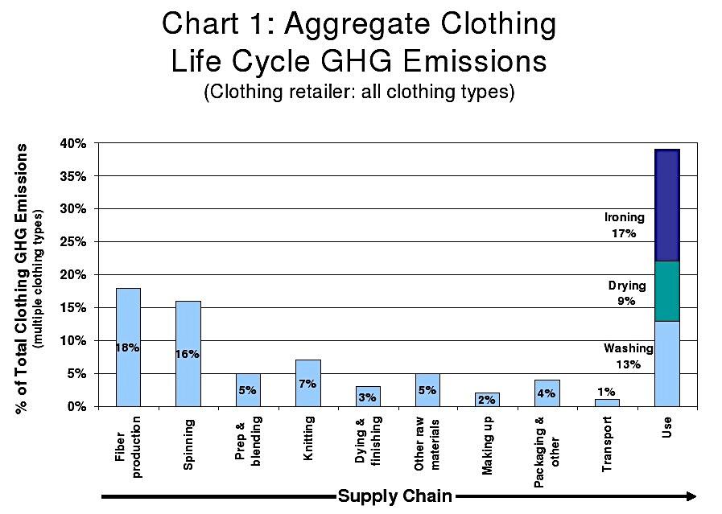
CO²
hotspot
CO²
hotspot
Notes:
There are two primary hotspots where GHG emissions spike in the textile product life cycle, fiber processing/production and care/maintenance, both phases of which are predicated on material choices. For example, GHG emissions are embodied in agricultural practices used to grow natural fibers. The agricultural practices and their efficiency (or lack thereof) have implications for land use (eg. Knocking down trees for fiber production reduces the ability for trees to clean the air and also creates greater implication of radiation, contributing to global warming). On the other hand, the fiber choices we make have implications for how they must be cared for, driving the energy and water use in the home for care and maintenance, which also have significant implications for GHG emissions. To address this issue, one approach that may be utilized to reduce overall energy production needs and energy consumption across the lifecycle is taking a Waste = Food approach to material selection and/or design.

Slide 8
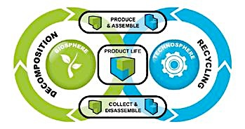
WASTE = FOOD

Slide 9
Cradle 2 Cradle Design Protocol:
3 Tenets
Use current solar income
Celebrate diversity
Waste = Food
Eliminating waste or using waste as a resource.
An emphasized feature of C2C
Utilizing a diverse assortment of resources, capitalizing on local habitat, and making things reflective of place.
Collecting and using energy efficiently and from renewable resources.

Slide 10
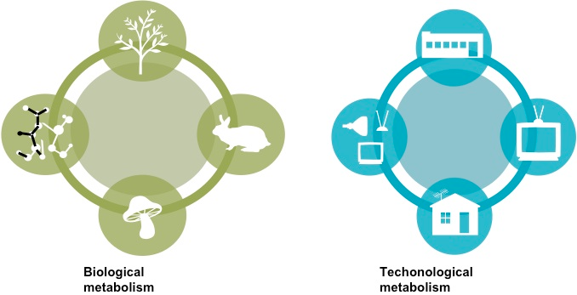
Waste = Food: Includes two material metabolisms
Notes:
The Waste = Food approach attempts to put all material use into one or both of the material metabolisms in an effort to either design things to decompose safely or to reuse them infinitely, as nature does with all of its materials. But first, we must understand some concepts and terminology about recycling and reuse…

Slide 11
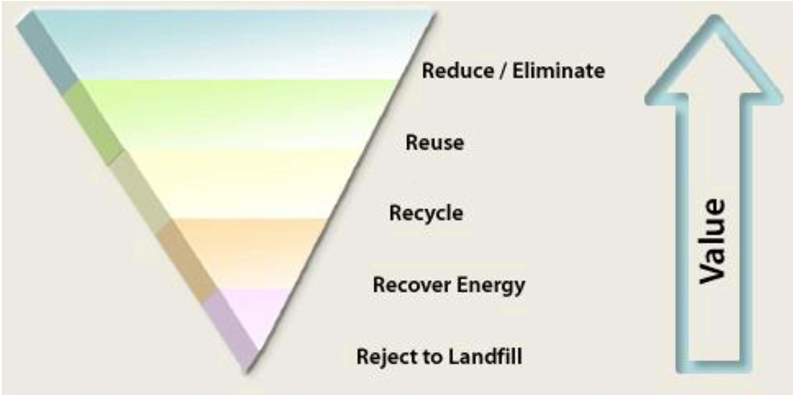
The Waste Hierarchy
Source: Directive 2008/98/EC on waste (Waste Framework Directive)
Cited from Textile Exchange
Notes:
These metabolisms are predicated on the assumption that as waste is reduced and/or eliminated, added value and competitive advantage (or food value) increases

Slide 12
Recycling vs. Reuse?
Recycling
  Collection, separating, and reprocessing at fiber/polymer level
Reusing
  Use of reclaimed materials as is
  No separating, no processing
  Materials may be cut up to capitalize on the largest pieces before re-use
  Or goods are used again in the second-hand context
Notes:
Often these terms are utilized interchangeably, but they mean very different things.

Slide 13
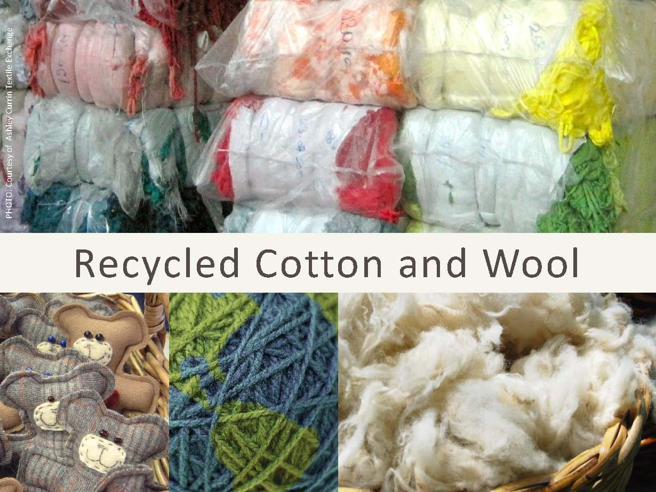
Recycled Natural Fibers
Image Source: Textile Exchange
Notes:
Many different types of textile fibers may be recycled, including natural and synthetic fibers, but each have special exceptions when considering the two metabolisms of the Waste = Food approach. Cotton and wool for example have both been recycled…

Slide 14
Input in Various Forms
Pre-consumer waste
  Cutting room waste
  Unsold items
Post-consumer waste
  Used apparel and home textiles
Often combined in different amounts and
blended with virgin fiber
Notes:
… this material is from several different sources of waste.

Slide 15
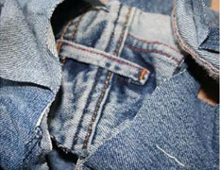
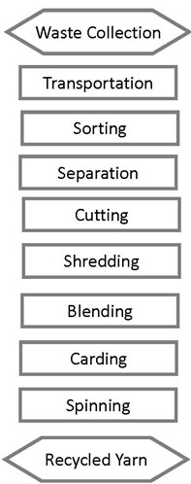
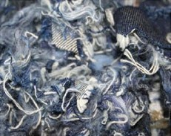
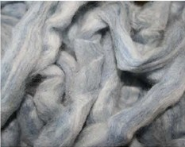
Recycling Process
Source: Textile Exchange
Notes:
Notice the process that recycling a fiber goes through…

Slide 16
Environmental Impact of Recycling
Reduces water used
Requires a lot less chemicals
Reduces greenhouse gas emissions
Replaces the need for farming
Reduces the amount of landfill disposal
Turns waste into useful products
Source: Textile Exchange
Notes:
These are some of the environmental payoffs to recycling such fiber.

Slide 17
Recycled Natural Fibers
Generally blended
Short staple fibers, in a range of sizes and qualities cannot easily be re-spun
Blending with longer staple virgin fibers on synthetic fibers improve yarn strength and spin ability
Unique look and feel
Somewhat coarser: open-end yarns
Mélange look: dyed waste
Final recycled content depends on fiber quality and material construction
Source: Textile Exchange
Notes:
Unfortunately, cellulosic and protein fibers may be recycled, however, it is difficult if not impossible at this time to create a technical metabolism with such, because there is a degradation of the quality of that material in its second life. These materials are often blended with other fibers during recycling, making that fabric very different from the first life it experienced.

Slide 18
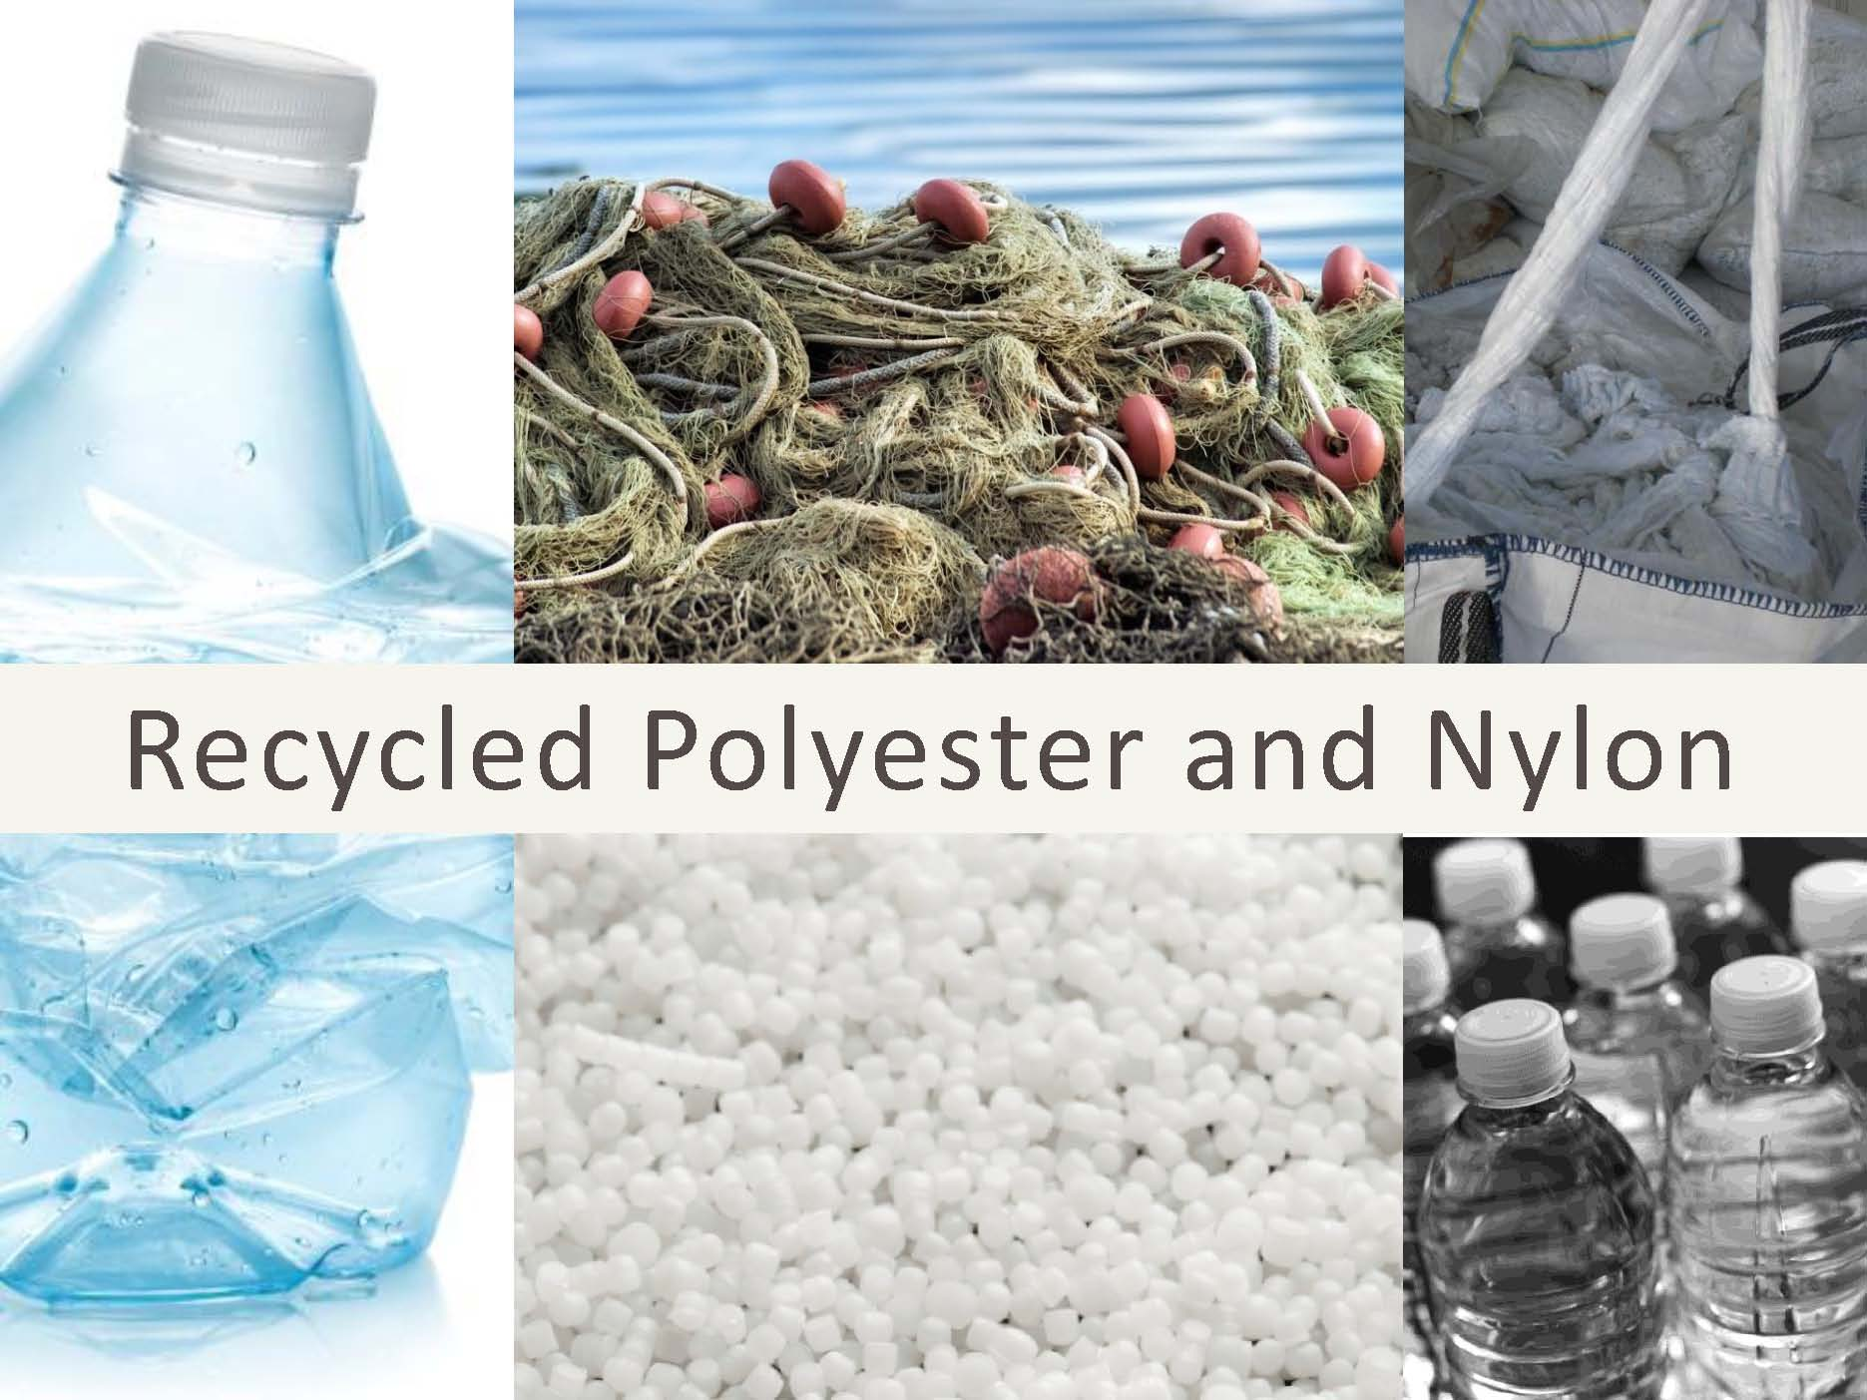
Recycled Synthetic Fibers
Source: Textile Exchange
Notes:
On the other hand, synthetics currently represent the greatest potential for a technical metabolism.

Slide 19

Input in Various Forms
Pre-consumer waste
  Cutting room waste
Post-consumer waste
  For polyester: bottles, garments
  For polyamide: fishing nets, carpets, garments
Often combined in differing amounts and
possibly including some virgin polymer
Source: Textile Exchange
Notes:
… this material is from several different sources of waste.

Slide 20
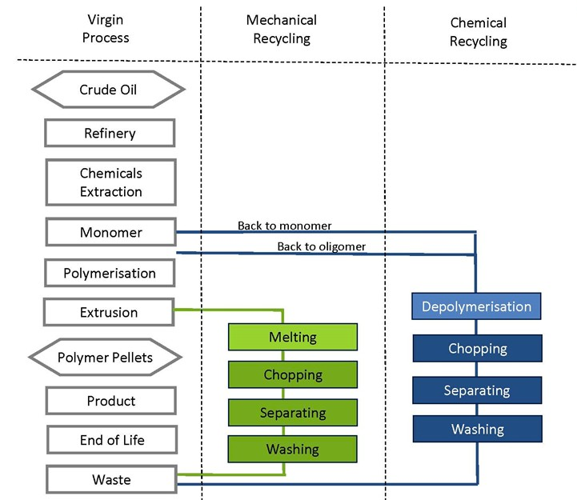
Mechanical and Chemical Recycling
Source: Textile Exchange
Notes:
Note, that only in chemical recycling is the polymer broken down to its smallest form before being utilized to recreate a new material. It is ONLY in this case that a technical metabolism can be created, because this takes the fiber to its purest form once again to recreate the same material that is the same or better quality than the first. In this case, there is NO degradation of material quality.

Slide 21
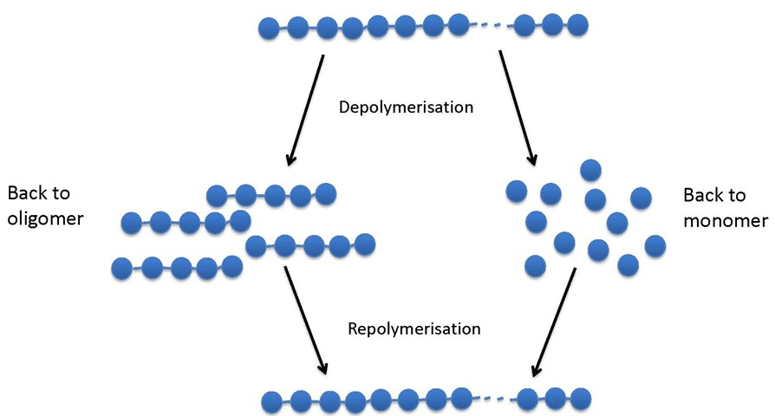
Depolymerisation and Repolymerisation
Source: Textile Exchange
Notes:
Note the process of repolymerization on the right is what happens during chemical recycling and must occur to achieve a technical metabolism.

Slide 22
 | Mechanical | Chemical (to Oligomer) | Chemical (to Monomer)
Process | Thermal decomposition through melting process | Decomposition into intermediary by chemical reaction | Decomposition into molecules by chemical reaction
Waster stream | Limited: Clear bottles & greige textiles | Limited: Clear bottles & greige textiles | Wider: Colored goods
Input | Labor, water Energy | Labor Water Energy Chemicals | Labor Water Energy Chemicals
Environmental Impact | * | ** | ***
Impurities | Yes | Yes but limited | No
Quality | Possible color limitations and unevenness | Possible color limitations | Same as virgin polymer
Close Loop | Materials’ life extension | Materials’ life extension | Close loop opportunity
Source: Textile Exchange
Notes:
A comparison of recycling methods for synthetic materials… note that chemical recycling is the only process where a closed loop opportunity exists. Also note, that of the recycling methods, the environmental impact of chemical recycling is most severe in comparison to other methods.

Slide 23
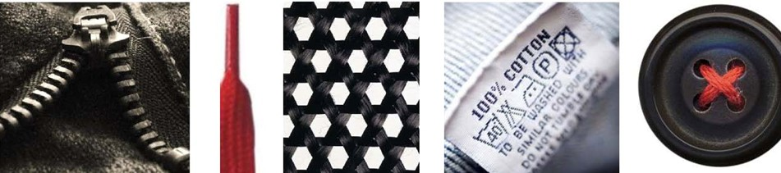
Recycled AT Products
Recycled materials can be turned into a wide range of products for apparel, accessories and footwear
  Textiles: knits, woven, tapes, labels, cords, laces
  Molded/Injected items: zippers, buttons, etc.
  Non-woven materials: waddings, interlinings
  Others: Packaging, sewing threads, etc.
Source: Textile Exchange

Slide 24
Recycling: Limitations
Quality and strength issues
  Knits have less tension
  Wovens may not be as strong (a solution would be to use recycled fiber in Weft and not Warp)
Aesthetics may be less polished
Requires major infrastructure
  Equipment, expertise, and logistical planning
Scale and availability issues
Source: Textile Exchange

Slide 25
Types of“Cycling”
Downcycling
Upcycling

Slide 26
Downcycling
What is Downcycling?
Examples
Creating new products from old, unusable or worthless products
These new products are worth less than the original product
Prevents waste of materials that can still be useful
  Recycling
    Nylon fiber into park benches
    Rubber shoe soles into rubber grind for running tracks
  Reuse
    Using old underwear, cut up for rags
Remember: In downcycling, you may mix material/fiber types, colors etc.

Slide 27
Video (optional)
Recycle and Sustainable Textiles
  Re-processing, Re-thinking (approx. 10 minutes)
Notes:
This video illustrates a downcycling application of recycling, which is not what Waste = Food is about.

Slide 28
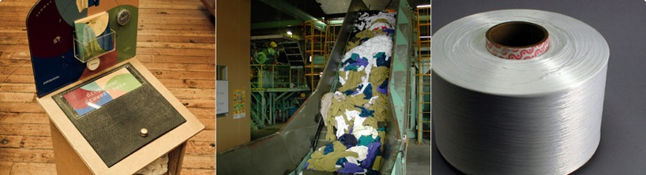
Upcycling
What is Upcycling?
Examples
Creating new products from old, unusable or worthless products
These new products are worth as much or more than the original product
Must begin with a material in pure form
Plastic bottle recycling = new PET fabric
Recycling PET fabric into new PET fabric without quality sacrifice
Notes:
C2C is all about upcycling, not downcycling!
C2C: Upcycling through Biological or Technical Metabolisms by creating output from the first lifecycle that is the same or better quality, has some “food value” to add to the next life, and the contribution is never lessened in the second, third, fourth life, etc.

Slide 29
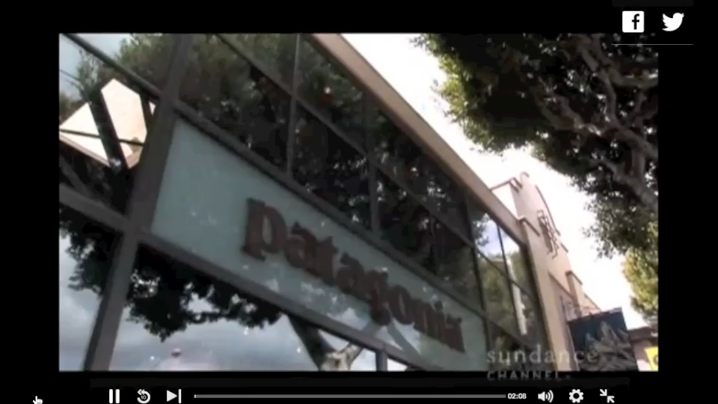
Upcycling with a Technical Metabolism: Common Threads

Slide 30
Waste = Food: Includes two material metabolisms
Notes:
The Waste = Food approach attempts to put all material use into one or both of the material metabolisms in an effort to either design things to decompose safely or to reuse them infinitely, as nature does with all of its materials. But first, we must understand some concepts and terminology about recycling and reuse…

Slide 31
Biological Metabolism
A biodegradable material posing no immediate or eventual hazard to living systems that can be used for human purposes and can safely return to the environment to feed environmental processes.
Biological nutrients evolve from the biosphere (systems of natural processes).
Notes:
Let’s look at each of these… Some products may biodegrade without adding anything valuable to the soil, and in some cases it is debatable whether biodegradability is in fact non-toxic.

Slide 32
Upcycling in a Biological Metabolism: Composting vs. Biodegradability?
Biodegradability simply means the waste will break down (like natural fibers & other organic materials) as opposed to existing in the environment for hundreds of years (like synthetics).
Compostability is reliant on waste’s “food value.” In other words, to be compostable, biodegraded waste must end its life with some nutrient value that can support new life (plants); meaning, it cannot contain any toxic content.
Notes:
This is the key difference between upcycling and downcycling and the difference between whether you are utilizing a biological or technical metabolism or whether you’re just simply reusing or biodegrading an object that has little value in the second life.

Slide 33
Technical Metabolism
A material that remains in a closed-loop system of manufacture, reuse, and recovery (the technical metabolism), maintaining its value through many product life cycles.
Technical nutrients evolve from the technosphere (system of human-created industrial processes).

Slide 34
Material Metabolisms
Biological Nutrients | Technical Nutrients
Organic materials | Inorganic/synthetic materials
Materials can be safely disposed of in any natural environment | Materials cannot be safely disposed of in any natural environment
Materials will decompose and become food for plants or animals | Materials can be used in a continuous industrial cycle without losing integrity or quality

Slide 35
Video
The Next Industrial Revolution
  Waste=Food
  Take notes to prepare for Jeopardy game!
  Note the terms:
    Products of Service
    Products of Consumption
Notes:
Video: The Next Industrial Revolution (Waste = Food segment, 23:44-36:31; also available on DVD)

Slide 36
References
Benyus, J.M. (1997). Biomimicry. New York:
HarperCollins Publishers, Inc.
Business for Social Responsibility. (2009). Apparel
industry life cycle carbon mapping. Retrieved from www.bsr.org
McDonough, W. & Braungart, M. (2004). Cradle to cradle.
New York: North Point Press.
Textile Exchange (March 28, 2012). Recycled Content
Webinar. Charline Ducas, host.

Slide 37
Questions or comments about this module may be directed to:
Cosette M. Armstrong, Ph.D.
Oklahoma State University
Cosette.armstrong@okstate.edu
405-744-3818

