Slide 1


Educator Instructions
REMOVE THIS SLIDE
BEFORE PRESENTING
Customize this presentation to fit your needs. Please add or remove content.

Slide 2


The information in these modules has been crafted to enhance your understanding of the key scientific elements of climate change, and provide resources for you to bring into the classroom to help students understand not only the urgent need for change, but also the opportunity to be part of the transformation toward sustainability.
WHY FOCUS ON CLIMATE CHANGE?
ATHENAS is a multi-national Initiative funded by the U.S. Department of Agriculture
Notes:
Climate change is a significant challenge today. The purpose of this module is to draw attention to the urgency of the climate change challenge.

Slide 3
WHY FOCUS ON CLIMATE CHANGE?
Climate change is one of the most urgent environmental concerns that we face
Already observing:
  Rising temperatures and sea levels
  Species adaptation and extinction
  Increased frequency and severity of extreme weather events
Will change agriculture, access to potable water, and where and how we live
Driving force of climate change is the production of greenhouse gases, including carbon dioxide
Notes:
Climate change is influencing, and being influenced by, all sectors of the apparel and textiles industry from fiber production to disposal or recycling of textile waste products. Professionals in the AT industry have the opportunity to develop new ways of responding to market demands with environmentally-responsible processes and products.
Of the many environmental concerns that we face, climate change is among the most urgent because we have set in motion a comprehensive change to the global climate that will impact multiple aspects of the biosphere. We are already observing rising temperatures and sea levels, species adaptation and extinction, and increased frequency and severity of extreme weather events.
Together, these will change agriculture, access to potable water, and where and how we live. The driving force of climate change is the production of greenhouse gasses, including carbon dioxide.

Slide 4

CLIMATE CHANGE ANIMATION SHOWS DEVASTATING EFFECTS
Notes:
https://youtu.be/S7jpMG5DS4Q

Slide 5
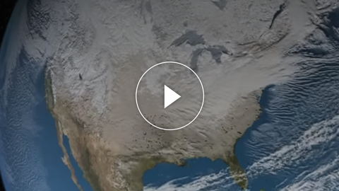
GAVIN SCHMIDT: THE EMERGENT PATTERNS OF CLIMATE CHANGE
Notes:
https://youtu.be/JrJJxn-gCdo

Slide 6
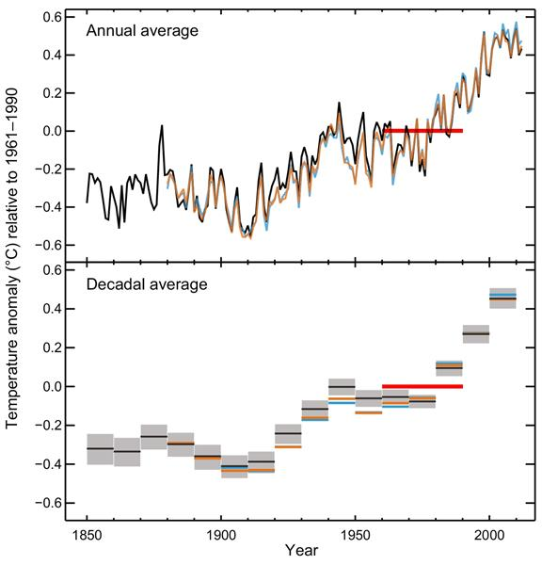
CLIMATE TRENDS
Chart is based upon observed data, not predictions
The standard was calculated during a period of 30 years (red horizontal line on the graph) and after warming trends were already observed
For reference, note that a 0.6 increase or decrease on the Celsius scale is equivalent to a 1.08 increase or decrease on the Fahrenheit scale
Figure SPM.1: Observed globally averaged combined land and ocean surface temperature anomaly 1850-2012
Graphic Source IPCC, 2013: Summary for Policymakers. In: Climate Change 2013: The Physical Science Basis. Contribution of Working Group I to the Fifth Assessment Report of the Intergovernmental Panel on Climate Change [Stocker, T.F., D. Qin, G.-K. Plattner, M. Tignor, S.K. Allen, J. Boschung, A. Nauels, Y. Xia, V. Bex and P.M. Midgley (eds.)]. Cambridge University Press, Cambridge, United Kingdom and New York, NY, USA. Retrieved from: http://www.climatechange2013.org/images/report/WG1AR5_SPM_FINAL.pdf
Notes:
Scientists have been measuring and recording global temperatures for well over a century. The graphic from the Intergovernmental Panel on Climate Change (IPCC) shows the observed globally averaged combined land and ocean surface temperature anomaly from 1850 to 2012 from three data sets.
An anomaly is the deviation from what is standard or expected.
The graph uses the average temperature of land and ocean (in Celsius) observed during 1961 to 1990 as the standard - represented by 0.0 on the left side of the graph.

Slide 7

2014 WARMEST YEAR ON RECORD AND NASA LAUNCHED CATS
Notes:
https://youtu.be/j91h4uUSXSI

Slide 8
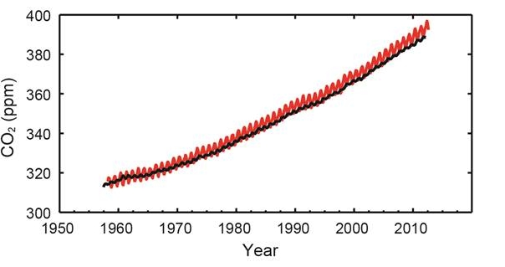
ATMOSPHERIC CO₂
The parts per million (ppm) of atmospheric CO₂ from 1958 through 2012 are shown. In 2015, we exceeded 400 ppm of atmospheric CO₂ as a monthly average.
Figure SPM. 4: Multiple observed indicators of a changing global carbon cycle
Graphic Source IPCC, 2013: Summary for Policymakers. In: Climate Change 2013: The Physical Science Basis. Contribution of Working Group I to the Fifth Assessment Report of the Intergovernmental Panel on Climate Change [Stocker, T.F., D. Qin, G.-K. Plattner, M. Tignor, S.K. Allen, J. Boschung, A. Nauels, Y. Xia, V. Bex and P.M. Midgley (eds.)]. Cambridge University Press, Cambridge, United Kingdom and New York, NY, USA. Retrieved from: http://www.climatechange2013.org/images/report/WG1AR5_SPM_FINAL.pdf
Notes:
The increase in atmospheric carbon dioxide (CO₂) is illustrated here.

Slide 9
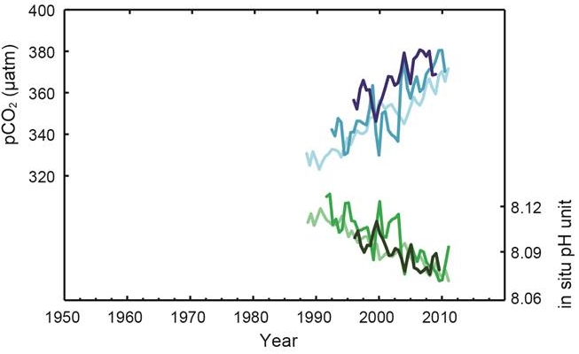
SURFACE OCEAN CO₂ AND pH
Increased levels of CO2 in seawater lowers pH values of the water
resulting in ocean acidification.
Figure SPM. 4: Multiple observed indicators of a changing global carbon cycle
Graphic Source IPCC, 2013: Summary for Policymakers. In: Climate Change 2013: The Physical Science Basis. Contribution of Working Group I to the Fifth Assessment Report of the Intergovernmental Panel on Climate Change [Stocker, T.F., D. Qin, G.-K. Plattner, M. Tignor, S.K. Allen, J. Boschung, A. Nauels, Y. Xia, V. Bex and P.M. Midgley (eds.)]. Cambridge University Press, Cambridge, United Kingdom and New York, NY, USA. Retrieved from: http://www.climatechange2013.org/images/report/WG1AR5_SPM_FINAL.pdf
Notes:
As seen in the IPCC figure, in conjunction with the increase in atmospheric carbon dioxide, CO₂ absorption levels in the oceans have increased. Approximately one fourth of our total carbon dioxide emissions are absorbed by the oceans. Increased levels of CO₂ in seawater lowers pH values of the water resulting in what is known as ocean acidification. This acidification is problematic because acidic ocean water results in fewer carbonate ions available for use by marine organisms (e.g. oysters, clams, corals, plankton) that build skeletons and shells out of calcium carbonate. The changing chemistry of the oceans puts marine ecosystems at risk. (National Oceanic and Atmospheric Administration)

Slide 10
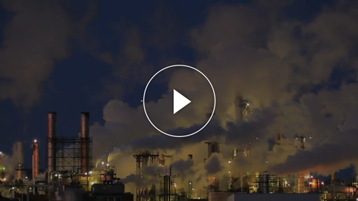
CLIMATE CHANGE. DO THE MATH!
The video provides a summary of the key issues related to climate change and describes how we can change our future by investing in, and implementing,
solutions now.
Notes:
https://vimeo.com/53979295

Slide 11
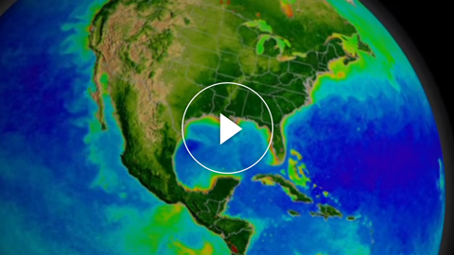
WHAT IS CLIMATE? CLIMATE CHANGE, LINES OF EVIDENCE
Notes:
https://youtu.be/qEPVyrSWfQE?list=PL38EB9C0BC54A9EE2

Slide 12


IN-CLASS ACTIVITY
The Department of Geosciences at Georgia State University has published a set of labs that may be helpful. Of particular interest is Lab 8 Recent Climate Variability & Change (Part 1) http://sites.gsu.edu/geog1112/lab8-1/

Slide 13
IPCC, 2013: Summary for Policymakers. In: Climate Change 2013: The Physical Science Basis. Contribution of Working Group I to the Fifth Assessment Report of the Intergovernmental Panel on Climate Change [Stocker, T.F., D. Qin, G.-K. Plattner, M. Tignor, S.K. Allen, J.Boschung, A. Nauels, Y. Xia, V. Bex and P.M. Midgley (eds.)]. Cambridge University Press, Cambridge, United Kingdom and New York, NY, USA
NASA website on climate science http://climate.nasa.gov/
A University of British Columbia online course http://www.youtube.com/user/climateliteracy
Of particular interest related to this section is Module 2.5 Climate Change in the Recent Past http://www.youtube.com/watch?v=-W5wgReG5Vc
Pacific Institute for Climate Solutions Examples of Global Warming (7:08 minutes) http://www.youtube.com/watch?v=MeBnenUq0Dk
MORE INFORMATION
AND RESOURCES

Slide 14
MORE INFORMATION
AND RESOURCES
(continued)
TED Talk Why I Must Speak Out About Climate Change – James Hansen (17:51 minutes) http://ed.ted.com/lessons/why-i-must-speak-out-about-climate-change-james-hansen
The New York Times article "Short Answers to Hard Questions About Climate Change" by Justin Gillis, November 28, 2015 http://www.nytimes.com/interactive/2015/11/28/science/what-is-climate-change.html
The New York Times article "2015 Was Hottest Year in Historical Record, Scientists Say" Justin Gillis, January 20, 2016 http://www.nytimes.com/2016/01/21/science/earth/2015-hottest-year-global-warming.html

Slide 15


