Slide 1


Educator Instructions
REMOVE THIS SLIDE
BEFORE PRESENTING
Customize this presentation to fit your needs. Please add or remove content.

Slide 2


Our understanding of climate change is based on scientific evidence. Respect for how science works is necessary to an understanding of the scientific evidence presented in the modules provided here.
HOW SCIENCE WORKS
ATHENAS is a multi-national Initiative funded by the U.S. Department of Agriculture
Notes:
The purpose of this module is to help you communicate to students the importance of the scientific method as a way of knowing. This module provides a way to share how the scientific process works so that when students read about scientific evidence and conclusions related to climate change, they value the scientific process and the outcomes communicated by scientific experts.

Slide 3
HOW SCIENCE WORKS
This resource provides a refresher on the process of science. It is recommended to enhance science literacy which is essential for understanding climate change and other environmental sustainability issues.
Key points from the “How Science Works” section of the "Understanding Science 101" website, developed by the University of California Museum of Paleontology at Berkeley, provides a dynamic and thorough review. The website is http://undsci.berkeley.edu/article/intro_01
An oversimplified, linear process often communicated to describe the scientific methods does not represent the reality of how science works.

Slide 4
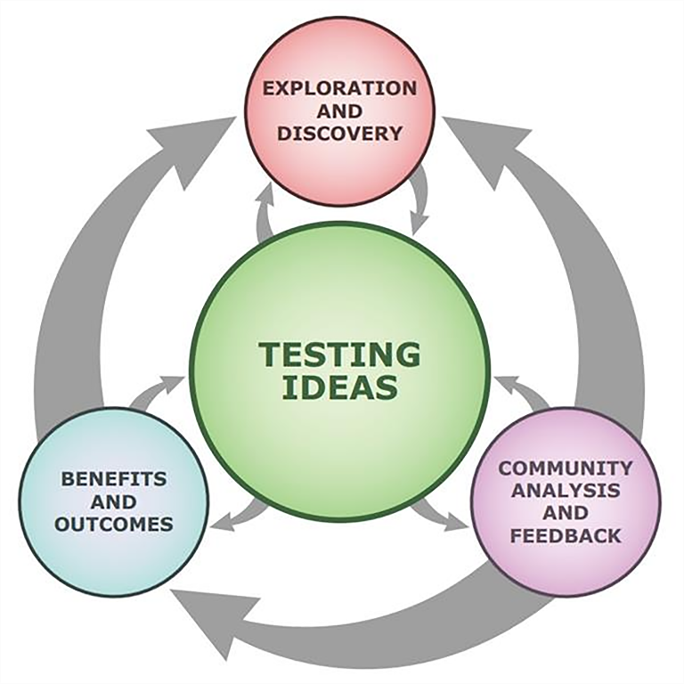
THE PROCESS IS NONLINEAR AND ITERATIVE
UC Berkeley Science Flow Chart--see interactive version at http://undsci.berkeley.edu/article/scienceflowchart
Source University of California Museum of Paleontology at Berkeley website http://undsci.berkeley.edu/article/intro_01
Notes:
Testing is a key part of the process and supports the other three aspects: exploration and discovery; community analysis and feedback; and benefits and outcomes.

Slide 5
CHARACTERISTICS OF A SCIENTIST
Knowledgeable
Honest
Open-minded
Curious
Skeptical
Rational
Unbiased
Conclusions reached by evidence
Notes:
Conclusions must be reached through evidence—not explained through tradition, reliance on authority, revelation, belief, or other supernatural explanations.

Slide 6
SCIENCE
According to Bell (2009), science is a body of knowledge, a set of methods or processes, and a way of knowing.

Slide 7
SCIENCE: A WAY OF KNOWING
Scientific knowledge is based on evidence and can change over time as new evidence is discovered.
Creativity, objectivity, and subjectivity play important roles in science.
Background knowledge influences how scientists view data.

Slide 8
CONSENSUS
Scientific consensus is when the community of scientists in a particular field of study reach a collective judgment.
Notes:
An important outcome to the scientific process is consensus building.

Slide 9
CONSENSUS IN SCIENCE
1
Dissemination of research results
2
Critical review of the disseminated work by other qualified experts
3
Challenge/validation through
re-creation of methods and processes and new research that attempts to answer the same question(s) through different methods and processes
Notes:
Scientists come to consensus through the process outlined.

Slide 10
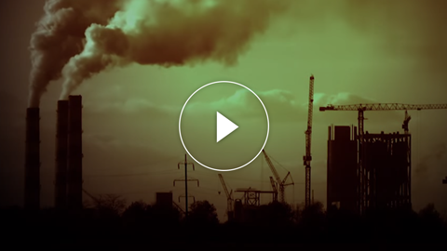
SCIENTIFIC CONSENSUS
- HOW IT FORMS
Notes:
https://youtu.be/jgg9VeFgh8E

Slide 11


IN-CLASS ACTIVITY
The following exercise about observations and inferences is from this website http://www2.gcs.k12.in.us/jcooke/Unit%201%20‐%20Intro%20to%20ICP/2012‐08‐15%20Observations%20and%20Inferences%20Part%20I.pdf
It is an example of a simple exercise that can be used to help students understand how observation and
inference differ.

Slide 12
MORE INFORMATION
AND RESOURCES
University of California Museum of Paleontology at Berkeley Teaching the Nature and Process of Science http://undsci.berkeley.edu/teaching/educational_research.php
NASA Climate Science Investigations The Nature of Science: Scientific Consensus and Certainty http://www.ces.fau.edu/nasa/introduction/scientific-inquiry/how-do-scientists-collaborate-and-reach-consensus.php

Slide 13


