Slide 1


Educator Instructions
REMOVE THIS SLIDE
BEFORE PRESENTING
Customize this presentation to fit your needs. Please add or remove content.

Slide 2


The purpose of this section is to provide information about the characteristics of greenhouse gases that contribute to their capacity to impact global warming.
GLOBAL WARMING POTENTIAL
ATHENAS is a multi-national Initiative funded by the U.S. Department of Agriculture

Slide 3
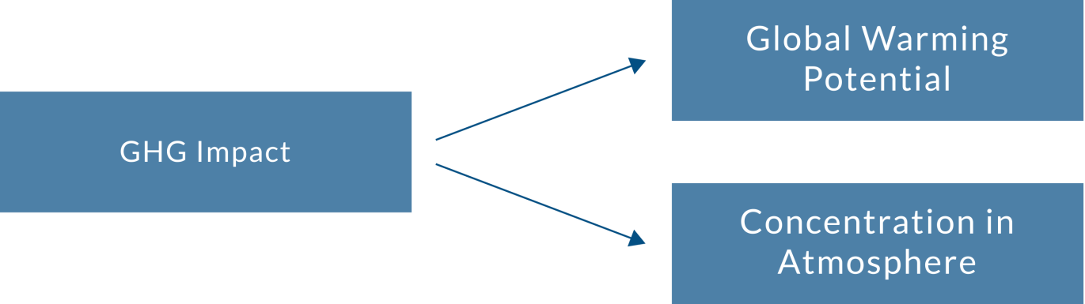
WHY ARE SOME GREENHOUSE GASES MORE POTENT THAN OTHERS?
The concentration level of a greenhouse gas in the atmosphere and the Global Warming Potential (GWP) of that gas combine to determine the impact it has on global warming.

Slide 4
CO₂ HAS A LONG LIFE IN THE ATMOSPHERE SO URGENCY OF ACTION TO REDUCE CO₂ EMISSIONS IS CRITICAL
Carbon dioxide is the greenhouse gas most commonly discussed because its atmospheric concentration is increasing and the increase is largely attributed to human activity. Thus we can change behaviors to impact the concentration in the atmosphere. An understanding of all greenhouse gases is necessary to appreciate the complex issue of the greenhouse effect and climate change.

Slide 5
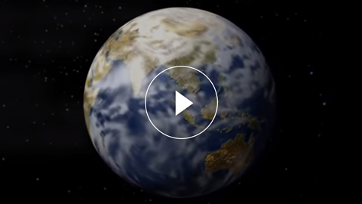
MORE THAN JUST CO₂
Even though carbon dioxide is a major contributor to global warming, other gases are at play including water vapour. This video explores those other gases and their impact on global warming.
Notes:
https://youtu.be/fA9NwUiU4sU

Slide 6
METHANE (CH4) IS ACTUALLY A MORE POTENT GHG THAN CARBON DIOXIDE
Methane (CH4), an off-gas produced by decaying organic matter such as animal excrement and debris in landfills, is actually a more potent GHG than carbon dioxide. However, there is much less methane than carbon dioxide in the atmosphere and it resides in the atmosphere for a much shorter time
than CO₂.
On a related note: Scientists are concerned about increasing levels of atmospheric CH4 being influenced by a positive feedback mechanism as global warming is causing the release of methane trapped in arctic permafrost as it thaws due to warmer temperatures.

Slide 7
GLOBAL WARMING POTENTIAL (GWP)
Has the rather confusing definition of the “amount of warming that a gas will cause in the next 100 years, compared to the same volume of
carbon dioxide."

Slide 8
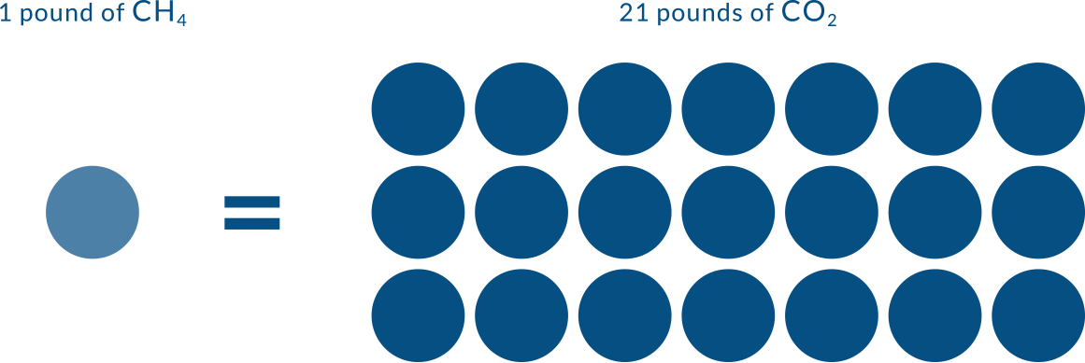
GLOBAL WARMING EFFECT OF METHANE VERSUS CARBON DIOXIDE
Notes:
In 100 years, a pound of methane will have the same global warming effect as approximately 21 pounds of carbon dioxide.
This graphic uses methane (CH₄) to illustrate how Global Warming Potential is conveyed.
This puts the Global Warming Potential of methane at 21 in this comparison to carbon dioxide. The range of GWP values typically referenced for methane over 100 years is between 21 and 38.
For more information about Global Warming Potential see this website http://www3.epa.gov/climatechange/ghgemissions/gwps.html

Slide 9
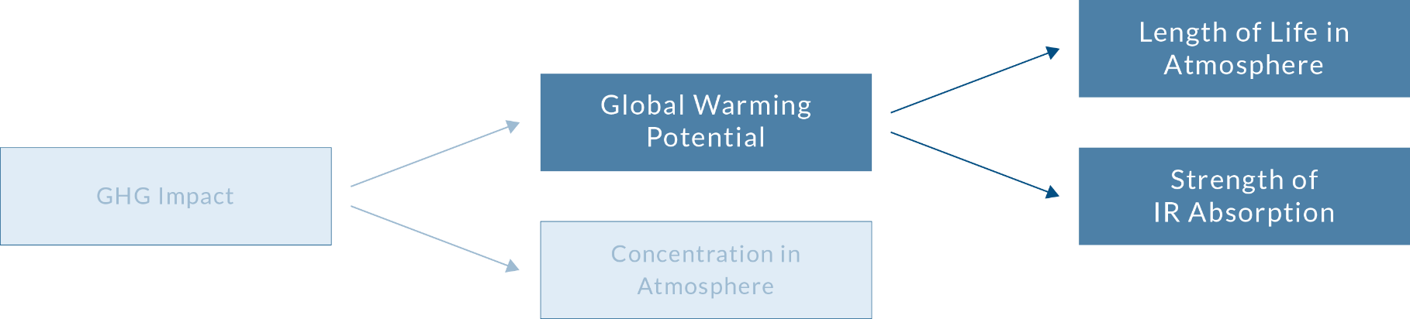
WHAT CONTRIBUTES TO GLOBAL WARMING POTENTIAL?

Slide 10
GLOBAL WARMING POTENTIAL FOR EACH GAS IN OUR ATMOSPHERE DEPENDS ON TWO THINGS:
1
HOW MUCH INFRARED (IR) LIGHT THE GAS ABSORBS
2
HOW LONG THE GAS STAYS IN
THE ATMOSPHERE
When infrared (IR) light strikes a bond, that bond absorbs the light and causes the bond to stretch. Some bonds can absorb more energy from the IR light than others.
Some global warming gases are more stable in the environment than others and some degrade faster than others. How long a gas stays in the atmosphere is called its residence time.
Notes:
HOW MUCH INFRARED (IR) LIGHT THE GAS ABSORBS
Compare this to what you know about the water absorbancy of cotton fibers versus polyester fibers. Cotton fibers naturally absorb more water than polyester fibers just like some molecular bonds can absorb more IR light than others.
HOW LONG THE GAS STAYS IN THE ATMOSPHERE
Global warming gas molecules in the atmosphere degrade because sunlight and other chemicals in the air break their bonds, or they go out into space, or they return to the surface of the earth.
A good analogy would be different degradation rates of paper and plastic when exposed to the outdoor environment. We expect both paper and plastic to deteriorate with environmental exposure, however we generally expect that paper will degrade faster than plastic when left outdoors.

Slide 11
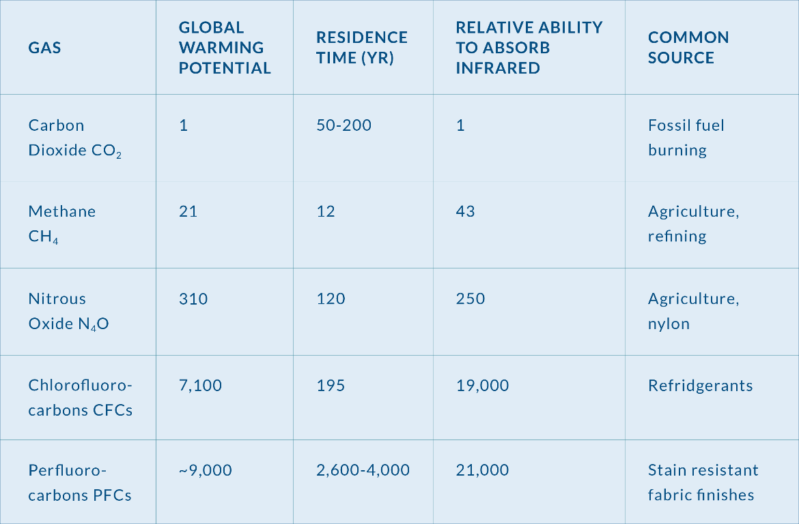
GLOBAL WARMING POTENTIAL
Notes:
The table shows common greenhouse gases, their GWP, residence time in years, relative ability to absorb IR and common sources. The sources of GHGs related to textile production have been highlighted here.
Notice the importance of these gases to the fabric and textile industries. Besides PFCs and N2O, the manufacture of all textiles requires energy to produce electricity and heat. Nearly all of the energy used in the industry is from fossil fuels. Methane is released in petroleum refining and fracking operations.
In addition to energy, petroleum provides the raw materials for production of many textiles.
N2O is a compound that comes from the manufacture of nylon, and is important in agricultural based textiles and dyes.
The residence time of several greenhouse gases are shown in the third column of the table.

Slide 12
ALL OF THE YEARS THAT THESE GASES ARE IN THE ATMOSPHERE THEY ARE ACTING AS GLOBAL WARMING GASES
These gases are absorbing IR light and contributing to increased temperatures.
Notice that carbon dioxide will stay in the atmosphere much longer than methane, and that PFCs, which are used on stain resistant fabrics, have very, very long residence times in the atmosphere. N20 also stays in the atmosphere a relatively long time of 120 years.

Slide 13
THE GLOBAL WARMING POTENTIAL IS A COMBINATION OF THE YEARS THE GAS WILL RESIDE IN THE ATMOSPHERE AND THE ABILITY OF THE GAS TO ABSORB INFRARED LIGHT ENERGY
Note for example, that the residence time of methane, CH4, is shorter than that for carbon dioxide, but it has a higher GWP because it strongly
absorbs IR radiation.

Slide 14
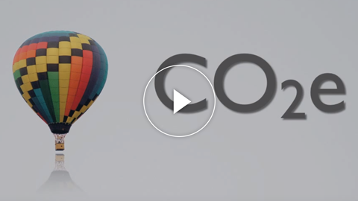
GWPS, EMISSION FACTORS, AND
CARBON VS. CO₂
Notes:
https://youtu.be/niotf0oHvQY

Slide 15

10 PERCENT
The apparel and textile industry accounts for nearly 10% of total global greenhouse
gas emissions
Source: Zaffalon, V. (2010). Climate change, carbon mitigation, and textiles.

Slide 16

MORE INFORMATION
AND RESOURCES
Pacific Institute for Climate Solutions Examples of Global Warming (7:09 minutes) http://www.youtube.com/watch?v=VttL3ZYQpy4&feature=youtu.be
EPA Climate Change website http://www3.epa.gov/climatechange/

Slide 17


