Slide 1


Educator Instructions
REMOVE THIS SLIDE
BEFORE PRESENTING
Customize this presentation to fit your needs. Please add or remove content.

Slide 2


This section focuses on the relevance of climate change to the apparel and textile industry. It describes how the industry contributes to climate change. The industry is changing in response to climate change.
CLIMATE CHANGE AND THE AT INDUSTRY
ATHENAS is a multi-national Initiative funded by the U.S. Department of Agriculture
Notes:
Students have a tremendous opportunity to be agents of change in the apparel and textiles industry.

Slide 3
APPAREL AND TEXTILES IS ONE OF THE BIGGEST GHG EMITTERS ON EARTH
As an industry, apparel and textiles is one of the biggest GHG emitters on Earth because of its huge size and global scope. In 2015, the global apparel and textile industry had a total value of nearly 2 trillion US dollars (http://www.slideshare.net/Euromonitor/state-of-the-apparel-and-footwear-market-in-2015).
Many processes and products necessary for making fibers, textiles and apparel products consume significant quantities of fossil fuels. As a result, the apparel and textile industry accounts for approximately 10% of total carbon emissions (Zaffalon, 2010).

Slide 4
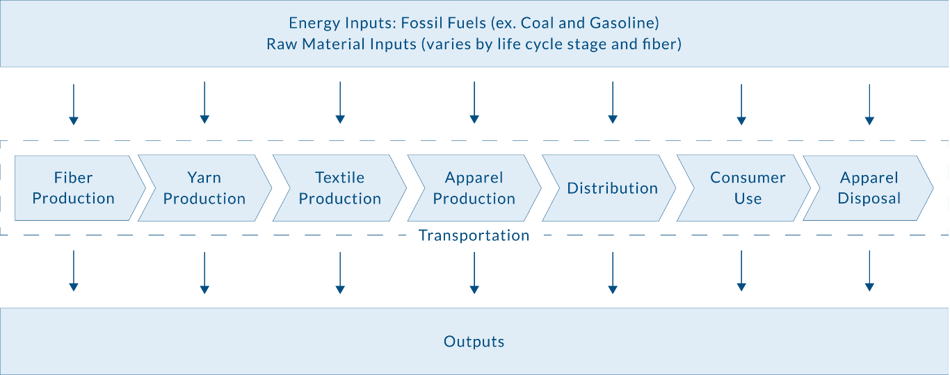
INPUTS AND OUTPUTS OF APPAREL
AND TEXTILE SUPPLY CHAIN
The following figure illustrates the apparel and textile supply chain with energy and raw material inputs recognized. It also indicates that there are outputs (such as solid and liquid waste and air pollution) at each stage.

Slide 5
THE MANUFACTURING OF BOTH TEXTILES AND APPAREL CARRIES HIGH
ENERGY DEMANDS
Both the inputs and the outputs relate to climate change because of the GHG emissions associated with energy production and consumption in all stages.
Manufacturing of both textiles and apparel depends heavily on industrial machinery, typically powered through the burning of fossil fuels.

Slide 6
CARBON FOOTPRINT
The total amount of CO₂ and other greenhouse gases (GHGs) emitted over the full life cycle of a process or product.

Slide 7
A CARBON FOOTPRINT TAKES INTO ACCOUNT ENERGY INPUTS AND EMISSION OUTPUTS THROUGHOUT THE WHOLE SUPPLY CHAIN
It is estimated that 60 billion kilograms of fabric are produced globally each year. This production requires 1 trillion kilowatt hours of electricity. Every Kilowatt hour of electricity produced by burning coal produces 900 grams of CO₂ (Conca, 2012).
Notes:
A carbon footprint takes into account energy inputs and emission outputs throughout the whole supply chain from raw materials to processing, transport, final use, and disposal. A carbon footprint is measured by weight and usually reported in either tons or kilograms.

Slide 8
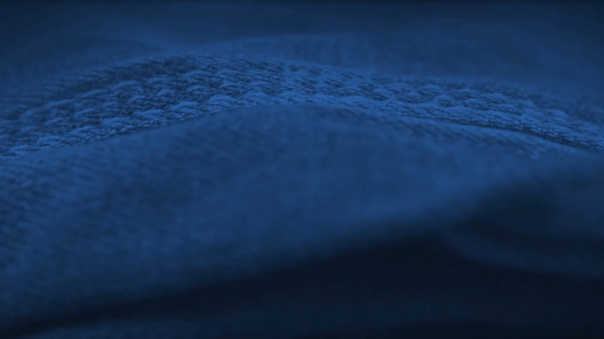
127,000 MEGAJOULES
Manufacturing 1 ton of polyester fiber consumes up to 127,000 megajoules, and in 2010, 64 billion pounds of polyester were produced.
Source: Cherret, N., Barrett, J., Clemett, A., Chadwick, M., & Chadwick, M.J. (2005).
Ecological footprint and water analysis of cotton, hemp, and polyester. Sweden: Stockholm Environment Institute.
Luke, J. (n.d.). Polyester a geography saga and all.
EIA. (2015). How much electricity does an American home use?

Slide 9
BUSINESS FOR SOCIAL RESPONSIBILITY (2009) CALCULATED AGGREGATE CLOTHING LIFE CYCLE GREENHOUSE GAS EMISSIONS AND DETERMINED THE FOLLOWING:
Fiber production accounted for 18% of total clothing greenhouse gas emissions
Spinning accounted for 16%
Consumer care for 39%
Other stages along the supply chain accounted for between 1% and 7% each

Slide 10
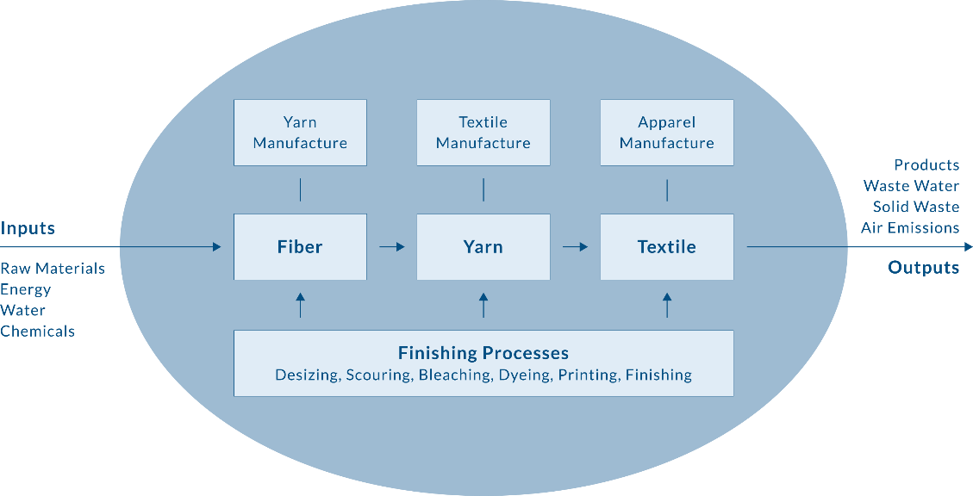
FOCUS ON THE STAGES OF FIBER, YARN
AND TEXTILE PRODUCTION
Notes:
This figure also includes the addition of the wet finishing processes of cleaning, dyeing, printing and finishing fibers, yarns and textiles, all of which are important processes to consider when examining climate change and the AT industry because these are energy intensive processes.
The carbon footprint associated with the spinning, knitting, dyeing, finishing, cutting and sewing required to manufacture 1kg of fabric can reach up to 12.5kg of CO2.
Compare this to the carbon footprint of steel which is about 2kg of CO2 per 1kg of steel (Zaffalon, 2010).

Slide 11
SELECTED FACTS TO CONSIDER REGARDING THE APPAREL AND TEXTILE INDUSTRY'S CARBON FOOTPRINT:
The primary energy source within the manufacturing of AT remains fossil fuels.
Many processes and products that go into making of fibers, textiles and apparel products consume significant quantities of fossil fuels.
Annually the AT industry produces 60 billion kilograms of fabric, which consumes 1 trillion kilowatt hours of electricity (Zaffalon, 2010).
In 2010 the electricity demands of the AT industry consumed 132 million tons of coal (Siegle, 2011).
The production and consumption of a 100% cotton tshirt consumes 109MJ of energy in order to grow and process the cotton fibers, manufacture and dye the yarns, knit the textile, construct the tshirt, launder it 25 times, and incinerate it after consumer disposal (Allwood et al., 2006).

Slide 12
CHINA AND INDIA ARE BOTH AMONG THE TOP TEXTILE AND APPAREL MANUFACTURING COUNTRIES IN THE WORLD
66% of China’s energy comes from coal and 20% from oil (http://www.eia.gov/beta/international/analysis.cfm?iso=CHN)
55% of India’s energy comes from coal (https://en.wikipedia.org/wiki/Energy_policy_of_India)
China and India combined are responsible for 54% of global consumption of coal (US Energy Information Administration, 2013 http://www.eia.gov/pressroom/presentations/sieminski_07252013.pdf)

Slide 13

IN-CLASS ACTIVITY
Activity: Carbon Footprint (Download PDF)
Slides to use with Carbon Footprint Activity
(View PowerPoint)

Slide 14
Forbes Report from United Nations introducing risks and opportunities for business: Climate Change Threatens Economic Growth- How Should Investors React http://www.forbes.com/sites/mikescott/2014/04/03/climate-change-threatens-economic-growth-un-report-how-should-investors-react/
CBS Money Watch Business leaders say climate change threatens economy http://www.cbsnews.com/news/business-leaders-say-climate-change-threatens-economy/
Bloomberg Business Which Sectors are most at Risk from Climate Change? http://www.bloomberg.com/news/videos/b/57b8dd7f-d120-4947-8fe8-f48154297c23
ABC Landline Climate Change and Agriculture http://www.abc.net.au/landline/content/2013/s3682086.htm
ABC Landline Wool Revival http://www.abc.net.au/landline/content/2015/s4258864.htm
Climate Change Pledge by leading apparel companies in response to COP21 http://www.ceres.org/files/apparel-statement/at_download/file
MORE INFORMATION
AND RESOURCES

Slide 15
Allwood, J.M., Laursen, S.E., de Rodríguez, C.M., & Bocken, N.M.P. (2006). Well dressed? The present and future sustainability of clothing and textiles in the United Kingdom. Cambridge, UK: University of Cambridge, Institute for Manufacturing.
Business for Social Responsibility. (2009). Apparel industry life cycle: Carbon mapping. [Online] Available: http://www.bsr.org/reports/BSR_Apparel_Supply_Chain_Carbon_Report.pdf
Conca, J. (2012). How deadly is your kilowatt? We rank the killer energy sources. Forbes Available: http://www.forbes.com/sites/jamesconca/2012/06/10/energys-deathprint-a-price-always-paid/
Siegle, L. (2011). To die for: Is fashion out of this world? London, UK: Fourth Estate.
Zaffalon, V. (2010). Climate change, carbon mitigation, and textiles. [Online] Available: http://www.textileworld.com/Issues/2010/July- August/Dyeing_Printing_and_Finishing/Climate_Change-Carbon_Mitigation_And_Textiles
REFERENCES

Slide 16


