Slide 1
Educator Instructions
REMOVE THIS SLIDE BEFORE PRESENTING
Customize this presentation to fit your needs. Please add or remove content.

Slide 2
The purpose of this module is to reinforce the urgency to act by identifying the environmental and social consequences of global warming.
IMPACTS OF CLIMATE CHANGE
ATHENAS is a multi-national Initiative funded by the U.S. Department of Agriculture
Notes:
The impacts of climate change are diverse and influence both natural and human systems. The impacts will challenge us to adapt for the purpose of mitigating and accommodating the changes to natural systems that will affect human systems such as food and fiber production, health and economics.
Educators have the potential to inspire decisions, actions, and change. The information in this module is focused on the impacts of climate change. It provides information and resources for you to bring into the classroom to help students understand not only the urgent need for change, but also the opportunity to be part of the transformation.

Slide 3
IMPACTS OF CLIMATE CHANGE
Rajendra K. Pachauri, while Chairman of the Intergovernmental Panel on Climate Change (IPCC), summarized key messages from the Fifth Assessment Report at the United Nations Climate Summit in 2014. The full message is available at this URL: http://www.ipcc.ch/pdf/press/140923_RP_statement_NY.pdf

Slide 4
ONE: HUMAN INFLUENCE
Atmosphere and oceans have warmed
Snow and ice have diminished
Sea level has risen
Notes:
Human Influence on the climate system is clear and clearly growing.

Slide 5
TWO: WE MUST ACT QUICKLY
Atmosphere and oceans have warmed
Snow and ice have diminished
Sea level has risen
Extreme droughts and floods
Collapse of ice sheets, flooding our coastal cities
Steady rise in our death toll, especially among the world’s poorest
Notes:
We must act quickly and decisively if we want to avoid increasingly destructive outcomes.

Slide 6
THREE: THE FUTURE
Renewable energy is a real option
Tremendous opportunity to improve energy efficiency
Further reduce emissions by stopping deforestation
Notes:
We have the means to limit climate change and build a better future.

Slide 7
NEGATIVE CONSEQUENCES OF CLIMATE CHANGE
Oxygen-poor ocean zones are growing
Rainforests are releasing CO₂ (a greenhouse gas) as regions become drier
Droughts are causing extensive vegetation die-off and greater incidents of forest fires, which release CO₂ into the atmosphere
Changes in migration patterns of birds and animals
Disruption to food chains
Species loss; for example coral reefs are adversely affected by rising ocean temperatures and acidification
Notes:
Not all consequences of climate change are negative, but the impact of the negative consequences far out weigh the potential benefits of the positive consequences.

Slide 8
IMPACTS OF MELTING ICE CAPS
Notes:
Significant impacts from melting ice caps:
Rising sea levels and release of methane (a greenhouse gas)
Loss of polar bear population
Salt water contamination of fresh water systems (rivers, aquifers, coastal wetlands, rice paddies)
Flooding of low-lying areas

Slide 9
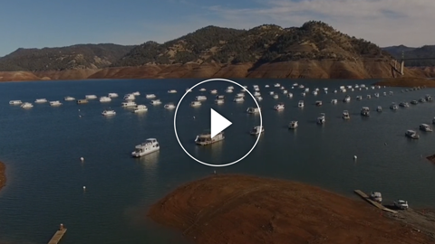
WHAT IT MEANS TO HAVE THE HOTTEST YEAR ON RECORD - AGAIN
Notes:
https://www.washingtonpost.com/video/c/embed/3be904be-bfc6-11e5-98c8-7fab78677d51
The video is by Chris Mooney of The Washington Post and addresses the NASA and NOAA findings that 2015 was the hottest year on record.

Slide 10
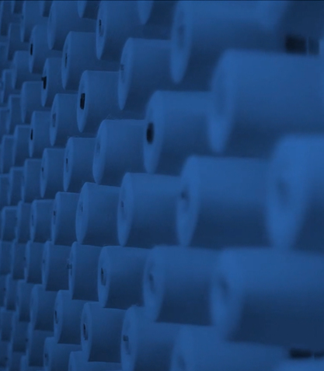
A University of British Columbia online course https://www.youtube.com/user/climateliteracy
Of particular interest: Module 7 Climate Change Impacts https://www.youtube.com/playlist?list=PLAHtWWrZTgn_t6r31ZT97B5X5w_wG_ndF
NASA Climate Science Investigations http://www.ces.fau.edu/nasa/
Focused on climate change impacts http://www.ces.fau.edu/nasa/impacts/
The Pacific Institute for Climate Solutions Climate Insights 101 http://pics.uvic.ca/education/climate-insights-101
Pacific Institute for Climate Solutions Examples of Global Warming (7:08 minutes) http://www.youtube.com/watch?v=VttL3ZYQpy4&feature=youtu.be
A video report on the evidence and impacts of climate change https://www.youtube.com/watch?v=j91h4uUSXSI
IPCC Fifth Assessment Report website http://ar5-syr.ipcc.ch/
Of particular interest: 2014 Summary for Policymakers by Working Group II on Impacts, Adaptation, and Vulnerability https://ipcc-wg2.gov/AR5/images/uploads/WG2AR5_SPM_FINAL.pdf
MORE INFORMATION AND RESOURCES

Slide 11
The Washington Post, What the Earth will be like in 10,000 years, according to scientists. https://www.washingtonpost.com/news/energy-environment/wp/2016/02/08/what-the-earth-will-be-like-in-10000-years-according-to-scientists/
Voice of America video on the impacts of climate change http://www.voanews.com/content/un-report-world-isnt-prepared-for-impacts-of-climate-change/1883060.html
This video includes global warming predictions for temperature and precipitation through the year 2099 http://www.space.com/22965-climate-change-impact-nasa-s-21st-century-predictions-video.html
The World Ocean Review provides an overview of the concerns for coastal areas as water levels rise http://worldoceanreview.com/en/wor‐1/coasts/
Skeptical Science provides thoughtful review of climate change "controversies" http://www.wunderground.com/climate/facts/negative_impacts.asp
MORE INFORMATION AND RESOURCES (continued)

