Slide 1


Educator Instructions
REMOVE THIS SLIDE
BEFORE PRESENTING
Customize this presentation to fit your needs. Please add or remove content.

Slide 2


World population is increasing, industrialization is expanding globally, income levels are rising in newly industrialized countries spurring greater levels of consumption. These realities are contributing to even more rapid increases in greenhouse gases.
ATMOSPHERE & GREENHOUSE GASES
ATHENAS is a multi-national Initiative funded by the U.S. Department of Agriculture

Slide 3
HUMAN BURNING OF FOSSIL FUELS IS A MAJOR CONTRIBUTOR TO THE ENHANCED GREENHOUSE EFFECT
The enhanced greenhouse effect caused by a greater buildup of carbon dioxide and methane (and other greenhouse gases) leads to less radiated heat leaving the atmosphere, resulting in warmer global temperatures.
Notes:
The natural greenhouse effect is necessary for the temperature of earth to support current life systems.
Scientists are confident that human burning of fossil fuels is a major contributor to the enhanced greenhouse effect.

Slide 4
ATMOSPHERE
Made up of gases. These gases regulate energy
transmission through the atmosphere.
Notes:
The atmosphere is where greenhouse gases come into the picture.
As an educator, be aware that some students believe that our atmosphere is only the clouds and above the clouds. It is essential for them to know that the atmosphere starts at the surface of the Earth and extends more than 300 miles outward from the surface of the Earth.

Slide 5
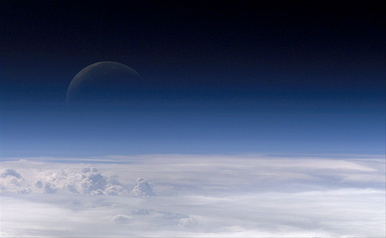
ILLUSTRATION OF EARTH’S ATMOSPHERE
Image Source: NASA http://earthobservatory.nasa.gov/IOTD/view.php?id=7373

Slide 6
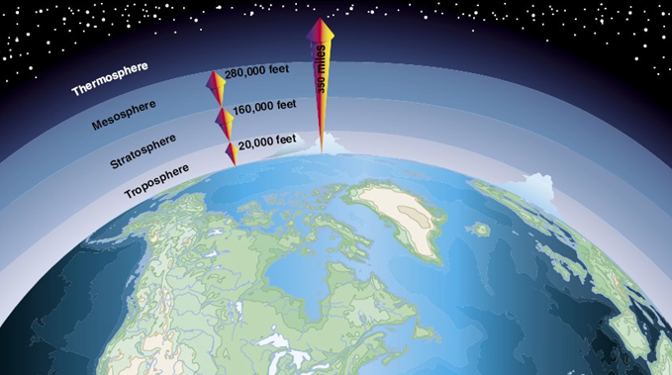
DIAGRAM OF EARTH’S ATMOSPHERE
Source: http://www.groundinstructor.com/mod/page/view.php?id=970

Slide 7
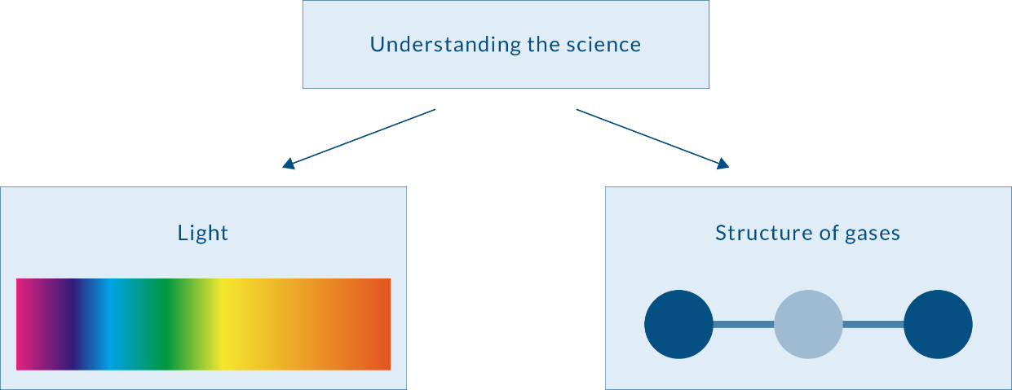
UNDERSTANDING THE SCIENCE OF THE GREENHOUSE EFFECT
In order to understand the basic science of the greenhouse effect, two concepts must be explained: the science of light and the structure of the gases in our atmosphere.

Slide 8

UNDERSTANDING THE SCIENCE OF LIGHT
Let’s begin with light. We’ll use “light” here to refer to all electromagnetic radiation (EMR) which includes many kinds of light such as ultraviolet light, infrared light, X-rays, microwaves and many more.
Light can be understood by three basic characteristics: wavelength, frequency and energy.
Light = Electromagnetic Radiation = EMR
Notes:
Under In the Classroom below there is a classroom activity that provides an easy way for students to remember these three basic characteristics.

Slide 9
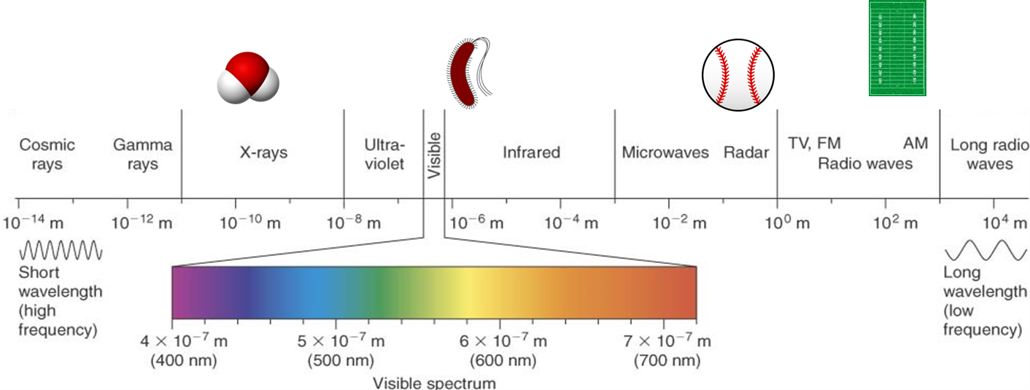
ELECTROMAGNETIC RADIATION
Notes:
Visible light spectrum is a small portion of the total type of electromagnetic radiation (EMR). To the left on this illustration there are shorter (invisible) ultraviolet wavelengths with higher frequency and more energy. The longer infrared wavelengths to the right of visible spectrum have lower frequency with less energy.

Slide 10
EACH WAVELENGTH HAS A FREQUENCY AND ENERGY ASSOCIATED WITH IT
Light (or EMR) has an incredible variation
in wavelength
  Very small wavelength and very energetic light like X-rays are very high energy
  Radio and TV waves are huge – often meters long, and of very low energy
Notes:
The whole range of EMR from the very short, very energetic cosmic rays to the very long, low energy radio waves acts the same way: Each wavelength has a frequency and energy associated with it.
We know they are high in energy because X-rays can go right through us to make the images of our bones we call “X-rays”!

Slide 11

127,000 MEGAJOULES
Manufacturing 1 ton of polyester fiber consumes up to 127,000 megajoules, and in 2010, 64 billion pounds of polyester were produced.
Source: Cherret, N., Barrett, J., Clemett, A., Chadwick, M., & Chadwick, M.J. (2005).
Ecological footprint and water analysis of cotton, hemp, and polyester. Sweden: Stockholm Environment Institute.
Luke, J. (n.d.). Polyester a geography saga and all.
EIA. (2015). How much electricity does an American home use?

Slide 12
That's enough energy to power
93 MILLION US HOMES FOR 1 YEAR
Source: Cherret, N., Barrett, J., Clemett, A., Chadwick, M., & Chadwick, M.J. (2005).
Ecological footprint and water analysis of cotton, hemp, and polyester. Sweden: Stockholm Environment Institute.
Luke, J. (n.d.). Polyester a geography saga and all.
EIA. (2015). How much electricity does an American home use?

Slide 13

IN-CLASS ACTIVITY
Demonstrating the wavelength, frequency, and energy of light (Download PDF)
Wavelength Activity (Video Demonstration)
POGIL Activity: The Earth’s Greenhouse (Download PDF)
About POGIL Activities:
You can learn more about POGIL at: https://pogil.org/about
What is POGIL? from The POGIL Project on Vimeo.

Slide 14
This link to a website called EXPLAINTHATSTUFF! provides an overview of the natural greenhouse effect http://www.explainthatstuff.com/globalwarmingforkids.html
The Department of Geosciences at Georgia State University has published a set of labs that may be helpful. Of particular interest are the following:
Lab 2 Stratospheric Ozone http://sites.gsu.edu/geog1112/lab-4/
Lab 3 The Troposphere http://sites.gsu.edu/geog1112/the-troposphere/
NASA A Year in the Life of Earth’s CO2 (3:10 minutes) https://www.youtube.com/watch?feature=player_embedded&v=x1SgmFa0r04
An overview of the Earth's atmosphere http://www.groundinstructor.com/mod/page/view.php?id=970
MORE INFORMATION
AND RESOURCES

Slide 15


